Slide 1
TURNING IDEAS INTO REALITY: ENGINEERING A BETTER WORLD
The Three Little Pigs
www.discovere.org
Notes:
Slide 1: As the pre-activity survey is distributed to students, introduce yourself and provide enough of an activity overview to gain students excitement.
Allow time for students to individually complete their pre-activity survey.
Divide group into teams of 3 students each (4 students will also work).

Slide 2
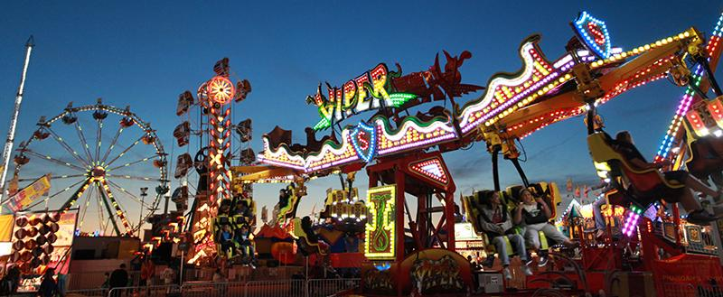
What does an engineer do?
Solve problems, and shape the future!
Create and design new “things” essential to health, happiness and safety:
Chemical things – food, medicine, shampoo, fuels…
Building things – bridges, skyscrapers, roads…
Technology things – iPods, Cameras, electronic gadgets…
Fun things – toys, roller coasters, sporting goods...
Important things – water systems, medical devices and tools…
Much, much more….the list is endless
images.businessweek.com
www.wistatefair.com
www.gettyimages.com
Notes:
2 and 3: Discuss engineering and what engineers do.

Slide 3
How do engineers do this?
Help others by solving all sorts of problems.
Use one of their most important tools: their own creativity.
Work in design teams.
Use cool tools such as computers, microscopes, testing machines, etc.
Communicate with lots of people about problems they need solved.
Share ideas and solutions with others through presentations and/or writing.
www.engineeringmessages.org
Notes:
Do all engineers do the same thing?
NO, NO, NO!!!!!
Many types of engineers
Chemical
Mechanical
Electrical
Civil
They do many different types of jobs
Design
Sale
Test
Much, much more!

Slide 4
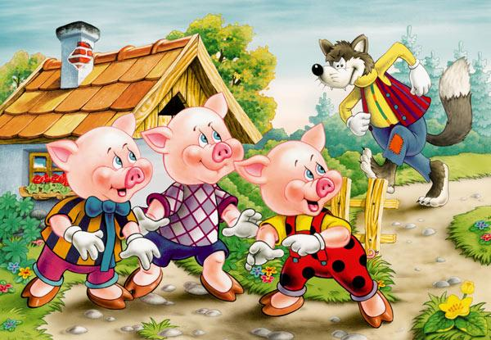
Today you will be a civil engineer – You will design, build, and test three different types of houses!
Engineering a Better World
Notes:
Present the engineering design problem and challenge, following the presentation:
Slide 4: Explain that they will be taking on the role of civil engineers.

Slide 5
Engineering Design Problem
You have finally earned enough money to build the house of your dreams near a Florida beach.
You want to make sure your structure is built to withstand the destructive force of a big bad wolf’s huffing and puffing to blow you house down!
WAIT…where you are building, hurricanes occur more frequently than the huffing and puffing of a big bad wolf.
In that case, a better idea is to make sure your structure is built to withstand the destructive forces of a hurricane’s wind, rain, and hail.
www.engineeringmessages.org
Notes:
Slide 5: Present the real-world engineering design problem (scenario).
You have finally earned enough money to build the house of your dreams near the beach in Florida. Unfortunately, hurricanes are a frequent occurrence in the area you are building. You must make sure that your home is built efficiently to withstand wind, rain, and hail. If not built properly, you may lose everything you have worked for in order to build your house. Using predetermined materials, you will build three different structures that will be tested with a fan, water, spilling beans.

Slide 6
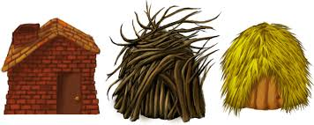
Engineering Design Challenge
Your team’s challenge is to build three different houses, each constructed with a material similar to what The Three Little Pigs used.
Straw, stick, and brick houses, built by The Three Little Pigs, were tested for their ability to withstand the destructive force of The Big Bad Wolf’s huffing and puffing. Your drinking straw, popsicle stick, and card houses will be tested for their ability to withstand the destructive forces of a hurricane’s wind, rain, and hail.
Notes:
Slide 6: Introduce the Engineering Design Challenge.

Slide 7
Design Goals
Build houses to withstand the forces of wind, rain, and hail.
Use only the provided materials.
Build in the time given.
House must be built on Wax Paper.
House Size: Length, Width, Height < 6 inches
House must include walls and a roof.
Have fun!!
Notes:
Slide 7: Discuss Engineering Design Goals.

Slide 8
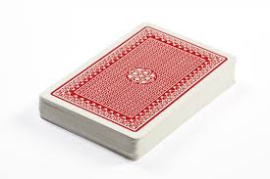
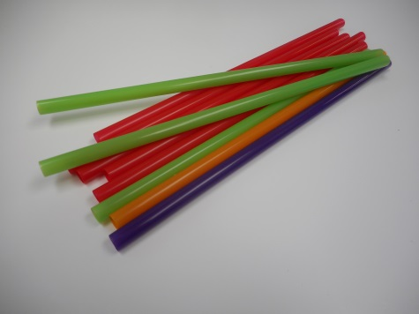
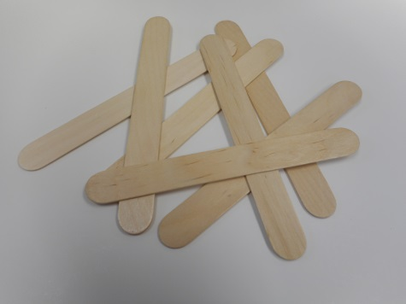
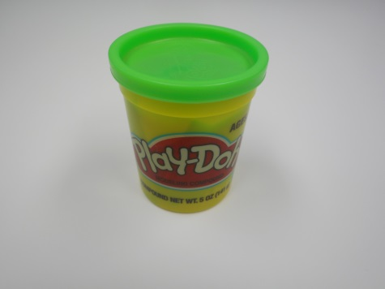
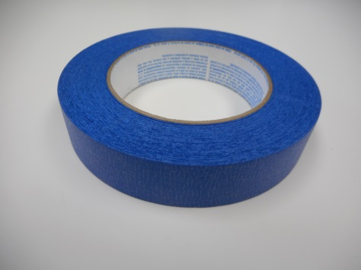
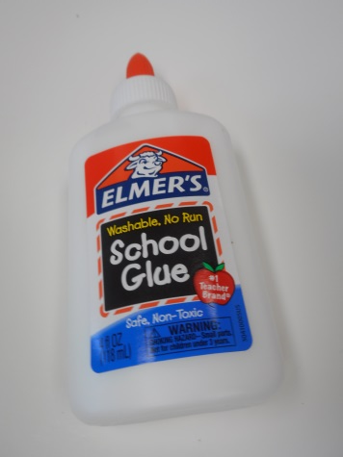
Materials
6
20
16
1
1 yd
1
stick/bottle
Notes:
Slide 8: Introduce resources (materials) available to each team.
You will have the following materials- Play dough, Painters Tape, Glue, Tongue Depressors, Deck of cards, Straws.
Use the following constraints:
Play dough- 1 tub
Painters Tape- 1 yard
Glue – 1 glue stick, elmer’s glue
Tongue Depressors- 16
Deck of cards- 6
Straws-20

Slide 9
Design Testing
Environmental Variables | Tools Used | Criteria
Wind | Blow Dryer | 5 inches away from House
Rain | Water | Pour 3 feet above house.
Hail | Beans | Pour 3 feet above house.
Notes:
Slide 9: Explain prototype-testing procedures.

Slide 10
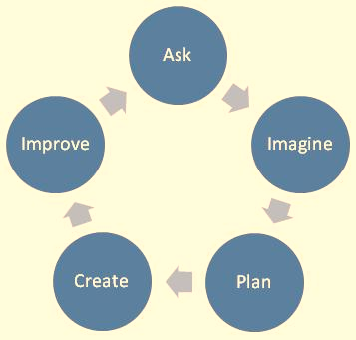
Engineering Design Process
ASK: What is the problem? How have others approached it? What are your constraints?
IMAGINE: What are some solutions? Brainstorm ideas. Choose the best one.
PLAN: Draw a diagram. Make lists of materials you will need.
CREATE: Follow your plan and create something. Test it out!
IMPROVE: What works? What doesn't? What could work better? Modify your designs to make it better. Test it out!
www.teachengineering.org
Notes:
Slide 10: Introduce the Engineering Design Process. Explain that engineers use it as a tool to help them more effectively solve problems.

Slide 11
Engineering Design Process
Imagine (10 min.)
INDIVIDUALLY: observe available materials, and brainstorm and write design ideas (5 min.)
TEAM: share individual ideas (5 min.)
Plan (5 min.)
Choose and sketch a team design plan
Create (10 min.)
Gather materials
Construct your team design plan
Improve and Test (10 min.)
Notes:
Slide 11: Explain how teams will use the engineering design process as they complete the challenge:
Imagine (10 min.)
INDIVIDUALLY: observe available materials, and brainstorm and write design ideas (5 min.)
TEAM: share individual ideas (5 min.)
Plan (5 min.)
Choose and sketch a team design plan
Create (10 min.)
Gather materials
Construct your team design plan
Improve and Test (10 min.)
Teams decide on and make any last minute improvements before testing
Each team tests their prototype while other teams observe.

Slide 12
Design Reflection
What went well? Not so well? Why?
What aspects of other team designs stood out to you?
Did other designs give you ideas for ways to improve your design?
What modifications would you make if we had time to complete the design challenge again?
How did the materials affect the ability for the houses to withstand the forces applied to them?
www.engineeringmessages.org
Notes:
Slide 12: Facilitate a whole group reflection on final prototype design and testing results by asking questions such as the following.
What do you like best about your design?
What do you like least about your design?
What aspects of other team designs stood out to you, and/or gave you ideas for improving your own team’s design?
What modifications would you make if we had time to complete the design challenge again?
How did the materials affect the ability for the houses to withstand the forces applied to them?

Slide 13
Wrap Up
What ideas do you have for engineering a better world?
How can you turn ideas into reality?
www.engineeringmessages.org
Notes:
Slide 13: Conclude by discussing the following questions as post-activity surveys are distributed.
What ideas do you have for engineering a better world?
How can you turn ideas into reality?

Slide 14
This material is based upon work supported by the National Science Foundation under Grant No. EEC – 1009607 and through EiF grant 14.06
References:
Smooth Operator Presentation by Margaret Pinnell
This work is sponsored in part by the Engineering Information Foundation Grant EiF14.06 and the National Science Foundation Grant under Grant No EEC-1009607
Engineering for the Three Little Pigs
http://teachers.egfi-k12.org/3-little-pigs/
Ohio's new learning standards. Ohio department of education. 08 Aug 2014. Retrieved from: http://education.ohio.gov/Topics/Ohio-s-New-Learning-Standards/Ohios-New-Learning-Standards
www.discovere.org
Notes:
Slide 14: Allow time for students to complete their post-activity survey.

