Slide 1
TURNING IDEAS INTO REALITY: ENGINEERING A BETTER WORLD
Smooth Operator
www.discovere.org
Notes:
Slide 1: As the pre-activity survey is distributed to students, introduce yourself and provide enough of an activity overview to gain students excitement.
Allow time for students to individually complete their pre-activity survey.
Divide group into teams of 2 to 4 students.

Slide 2
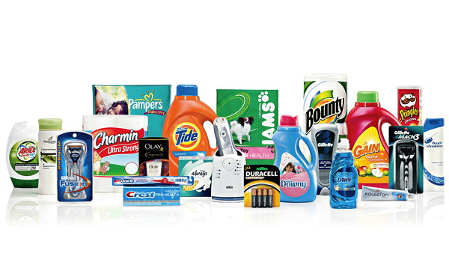
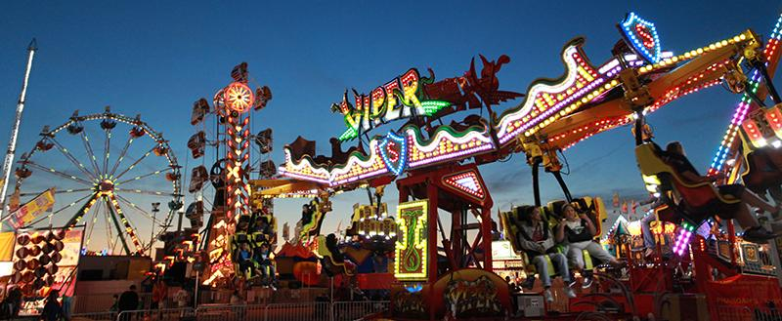
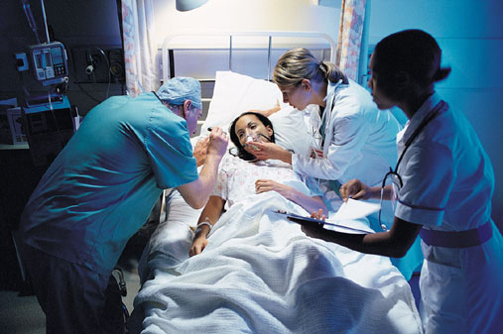
What does an engineer do?
Solve problems, and shape the future!
Create and design new “things” essential to health, happiness and safety:
Chemical things – food, medicine, shampoo, fuels…
Building things – bridges, skyscrapers, roads…
Technology things – iPods, Cameras, electronic gadgets…
Fun things – toys, roller coasters, sporting goods...
Important things – water systems, medical devices and tools…
Much, much more….the list is endless
images.businessweek.com
www.wistatefair.com
www.gettyimages.com
Notes:
Slides 2 and 3: Discuss engineering and what engineers do.

Slide 3
How do engineers do this?
Help others by solving all sorts of problems.
Use one of their most important tools: their own creativity.
Work in design teams.
Use cool tools such as computers, microscopes, testing machines, etc.
Communicate with lots of people about problems they need solved.
Share ideas and solutions with others through presentations and/or writing.
www.engineeringmessages.org
Notes:
Do all engineers do the same thing?
NO, NO, NO!!!!!
Many types of engineers
Chemical
Mechanical
Electrical
Civil
They do many different types of jobs
Design
Sale
Test
Much, much more!

Slide 4
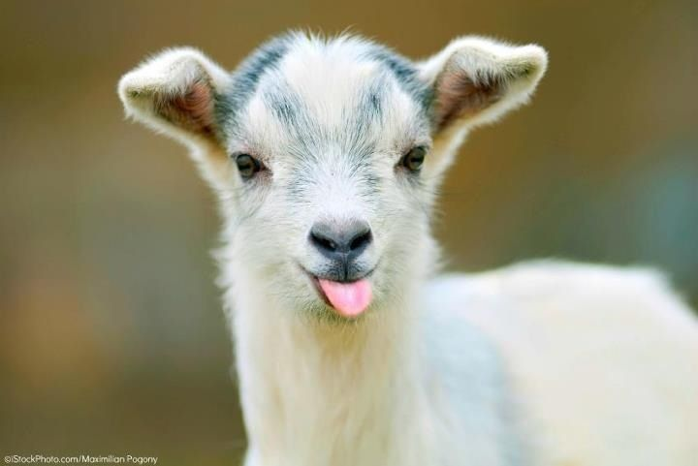
Today you will be a biomedical engineer – You will design, build and test a lifesaving device!
Engineering a Better World
Notes:
Present the engineering design problem and challenge, following presentation:
Slide 4: Explain that they will be taking on the role of a biomedical engineer to create a lifesaving device.

Slide 5
Engineering Design Problem
Your friend has a farm with three pet goats. One of the goats ate something funny that must be removed from its stomach.
Goats eat the weirdest things!
www.engineeringmessages.org
Notes:
Slide 5: Present the real-world engineering design problem (scenario).

Slide 6
Engineering Design Challenge
Your team’s challenge is to build a surgical instrument that can safely remove an object from a goat’s stomach.
You cannot hurt the goat or damage the objects.
The dominoes represent the goat’s stomach, so be careful not to hurt the goat by knocking over dominoes.
www.engineeringmessages.org
Notes:
Slide 6: Introduce the Engineering Design Challenge.

Slide 7
Design Goals
Create a device capable of retrieving objects from inside the wall of dominoes (goat’s body).
Make sure the device is able to be moved carefully, without knocking over dominoes! That would be like knocking into the inside of the goat’s stomach…OUCH!
Have fun!!
Notes:
Slide 7: Share Engineering Design Goals.

Slide 8
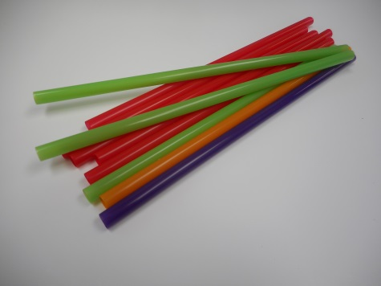
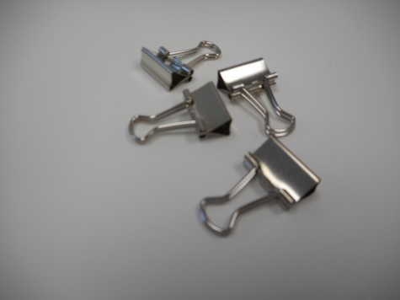
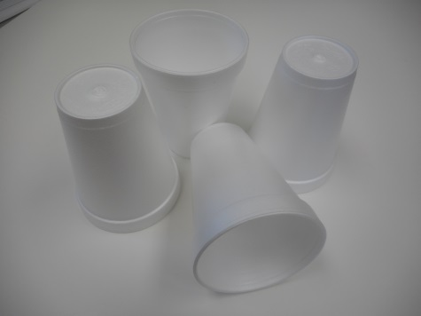
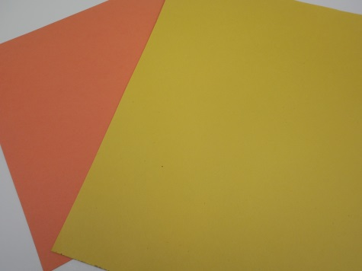
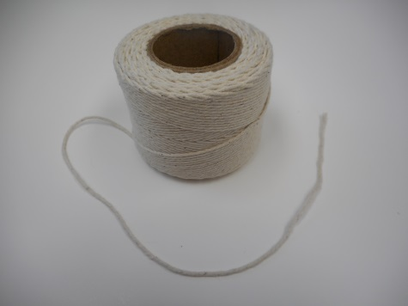
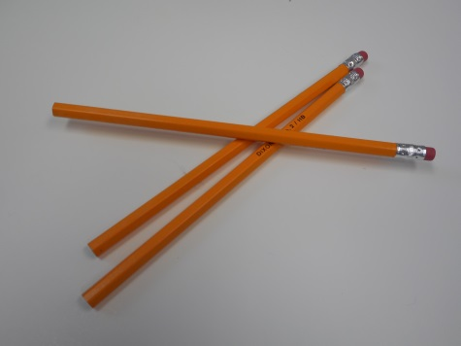
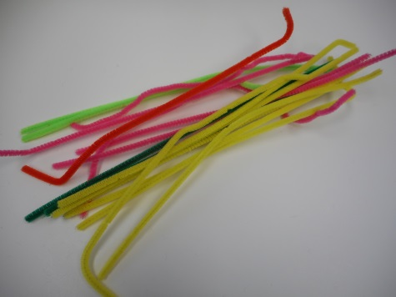
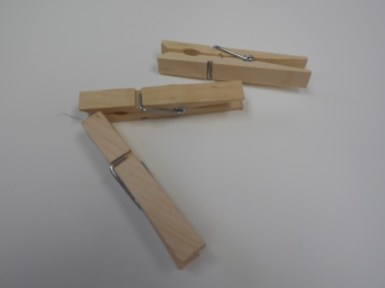
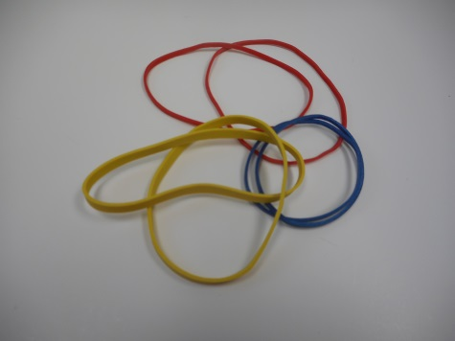
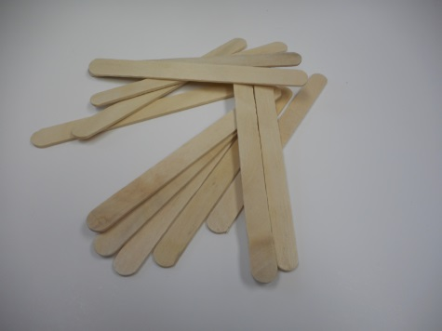
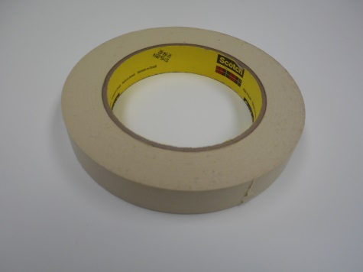
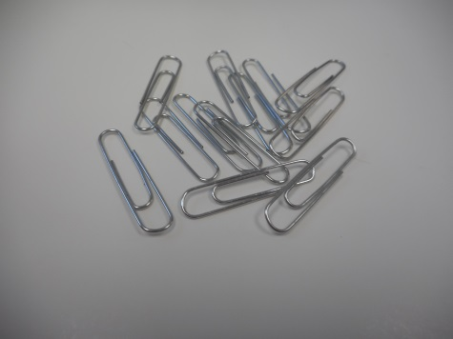
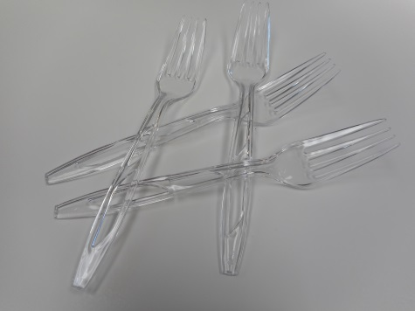
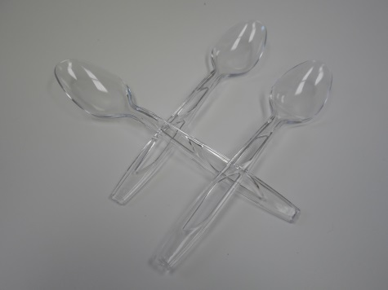
Materials
6
1
1
1
1 ft
2
2
1
4
4
6 in
3
3
2
Notes:
Slide 8: Introduce resources (materials) available to each team.

Slide 9
Design Testing
Dominoes will be setup around the edge of a box, representing the goats stomach.
The device will have to enter the box, grab, and remove the object eaten by the goat causing harm (without knocking over any of the dominoes)!
Success is measured based on how many dominoes are left standing.
In the case of a tie, the team that removes the object fastest, while knocking over the least amount of dominoes wins.
Notes:
Slide 9: Explain prototype-testing procedures.

Slide 10
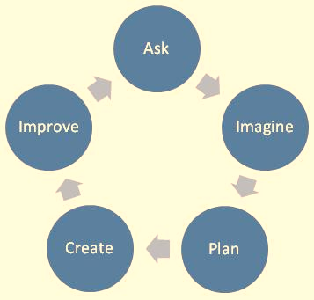
Engineering Design Process
ASK: What is the problem? How have others approached it? What are your constraints?
IMAGINE: What are some solutions? Brainstorm ideas. Choose the best one.
PLAN: Draw a diagram. Make lists of materials you will need.
CREATE: Follow your plan and create something. Test it out!
IMPROVE: What works? What doesn't? What could work better? Modify your designs to make it better. Test it out!
www.teachengineering.org
Notes:
Slide 10: Introduce the Engineering Design Process. Explain that engineers use it as a tool to help them more effectively solve problems.

Slide 11
Engineering Design Process
Imagine (10 min.)
INDIVIDUALLY: observe available materials, and brainstorm and write design ideas (5 min.)
TEAM: share individual ideas (5 min.)
Plan (5 min.)
Choose and sketch a team design plan
Create (10 min.)
Gather materials
Construct your team design plan
Improve and Test (10 min.)
Notes:
Slide 11: Explain how teams will use the engineering design process as they complete the challenge.
Imagine (10 min.)
INDIVIDUALLY: observe available materials, and brainstorm and write design ideas (5 min.)
TEAM: share individual ideas (5 min.)
Plan (5 min.)
Choose and sketch a team design plan
Create (10 min.)
Gather materials
Construct your team design plan
Improve and Test (10 min.)
Teams decide on and make any last minute improvements before testing
Each team tests their prototype while other teams observe. Teams test out their designs on the two box “goats”. They determine issues that need modified, and then make adjustments if time allows.

Slide 12
Design Reflection
What went well? Not so well? Why?
What aspects of other team designs stood out to you?
Did other designs give you ideas for ways to improve your design?
What modifications would you make if we had time to complete the design challenge again?
www.engineeringmessages.org
Notes:
Slide 12: Facilitate a whole group reflection on final prototype design and testing results by asking questions such as the following.
What do you like best about your design?
What do you like least about your design?
What aspects of other team designs stood out to you, and/or gave you ideas for improving your own team’s design?
What modifications would you make if we had time to complete the design challenge again?

Slide 13
Wrap Up
What ideas do you have for engineering a better world?
How can you turn ideas into reality?
www.engineeringmessages.org
Notes:
Slide 13: Conclude by discussing the following questions as post-activity surveys are distributed.
What ideas do you have for engineering a better world?
How can you turn ideas into reality?

Slide 14
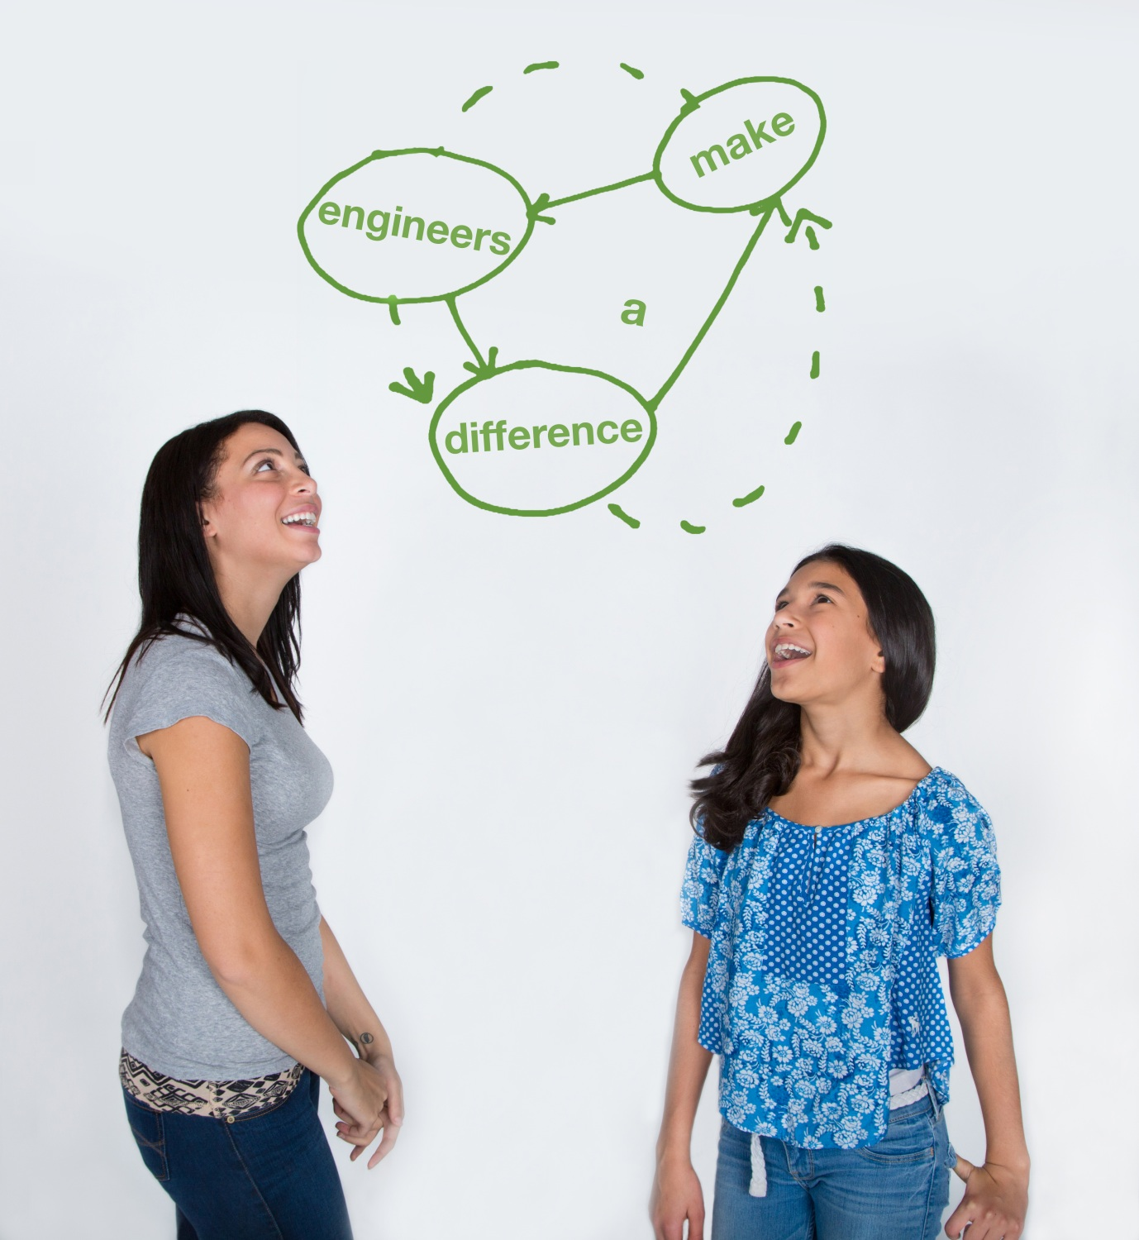
This material is based upon work supported by the National Science Foundation under Grant No. EEC – 1009607 and through EiF grant 14.06
References:
Ohio's new learning standards. Ohio department of education. 08 Aug 2014. Retrieved from: http://education.ohio.gov/Topics/Ohio-s-New-Learning-Standards/Ohios-New-Learning-Standards
www.discovere.org
Notes:
Allow time for students to complete their post-activity survey.

