Slide 1
TURNING IDEAS INTO REALITY: ENGINEERING A BETTER WORLD
Cracker Catapult
www.discovere.org
Notes:
Slide 1: As the pre-activity survey is distributed to students, introduce yourself and provide enough of an activity overview to gain students excitement.
Allow time for students to individually complete their pre-activity survey.
Divide group into teams of 2 to 4 students

Slide 2
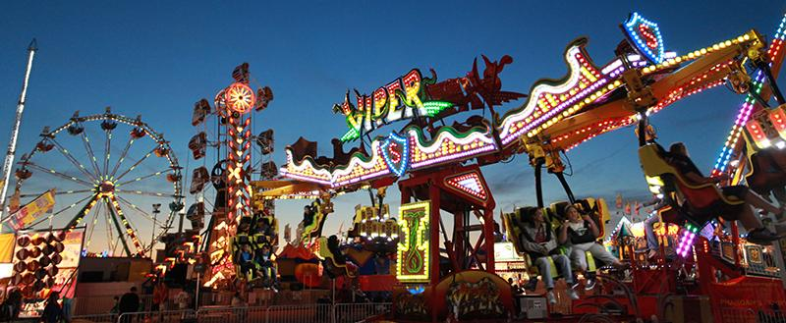
What does an engineer do?
Solve problems, and shape the future!
Create and design new “things” essential to health, happiness and safety:
Chemical things – food, medicine, shampoo, fuels…
Building things – bridges, skyscrapers, roads…
Technology things – iPods, Cameras, electronic gadgets…
Fun things – toys, roller coasters, sporting goods...
Important things – water systems, medical devices and tools…
Much, much more….the list is endless
images.businessweek.com
www.wistatefair.com
www.gettyimages.com
Notes:
Slides 2 and 3: Discuss engineering and what engineers do.

Slide 3
How do engineers do this?
Help others by solving all sorts of problems.
Use one of their most important tools: their own creativity.
Work in design teams.
Use cool tools such as computers, microscopes, testing machines, etc.
Communicate with lots of people about problems they need solved.
Share ideas and solutions with others through presentations and/or writing.
www.engineeringmessages.org
Notes:
Do all engineers do the same thing?
NO, NO, NO!!!!!
Many types of engineers
Chemical
Mechanical
Electrical
Civil
They do many different types of jobs
Design
Sale
Test
Much, much more!

Slide 4
Today you will be a mechanical engineer – You will design, build and test a catapult and cushioning system!
Engineering a Better World
Watch the video!
https://www.youtube.com/watch?v=XggxeuFDaDU
Help launch supplies across the river because the bridge collapsed!
Notes:
Present the engineering design problem and challenge, following presentation:
Slide 4: Play video (1m, 12s).
https://www.youtube.com/watch?v=XggxeuFDaDU

Slide 5
Engineering Design Problem
An earthquake in Hawaii has collapsed the only bridge leading into or out of a town, and the town’s people need of supplies!
In order to transport supplies over the collapsed bridge, the neighboring town built a catapult and is flinging materials from one side to the other!
A great amount of force is being applied to the materials in order to transfer enough kinetic energy and speed for them to make to the other side. Many supplies are being damaged because their high speeds and amount of kinetic energy causes them to hit the ground with great force.
The town’s people are trying to solve this problem by designing a way to protect supplies from being damaged as they are sent to the town in need.
Notes:
Slide 5: Present the real-world engineering design problem (scenario).

Slide 6
Engineering Design Challenge
Your team’s challenge is design a way to safely transfer the potential energy in the catapult to kinetic energy in the crackers without crackers breaking upon impact.
Your design can include only the materials provided.
Notes:
Slide 6: Introduce the Engineering Design Challenge, stressing that each team will only receive on packet of crackers and they have to be careful not to break them.

Slide 7
Build a Catapult
First your team needs a catapult!
Follow this video’s instructions:
http://www.youtube.com/watch?v=XchdUB-ZnKc
2 sticks
3 rubber bands
8 sticks
Notes:
Slide 7: Play the video (2m19s), and have teams follow instructions to quickly build a catapult.
http://www.youtube.com/watch?v=XchdUB-ZnKc
Each group gets 8 craft sticks for the base and two for the stand and catapult arm.
Three rubberbands

Slide 8
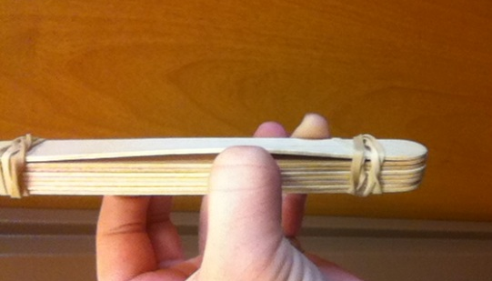
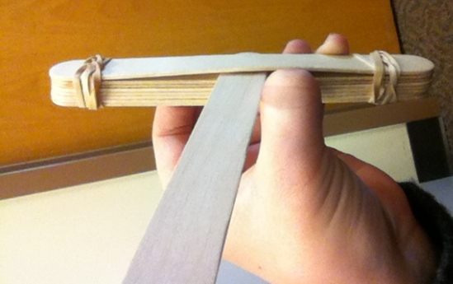
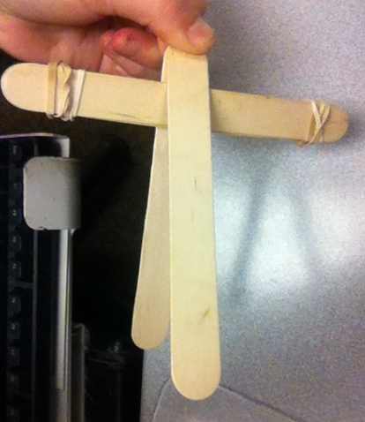
Divide sticks into group of 8 and group of 2 and have 3 rubber bands
Stack the 8 sticks and loosely wrap a rubber band around each end like in the picture. (about three or four times)
Lift between the last stick in the 8 stick pile.
Insert one of the sticks from your pile of two and insert it in the area made by lifting between the pile.
Take last craft stick that is left over from the two stick pile and pinch it to the stick you just placed in between the last stick 8 stick pile.
6. Wrap last rubber band around two sticks where you are pinching. (Wrap as many times as possible )
Notes:
Slide 8: Display the visual instructions for building a catapult as teams finish their catapults.

Slide 9
Design Goals
Create a working catapult that can throw a cracker packet.
Use only the materials provided to create a cushioning system to protect the cracker from breaking.
Have fun!!
Notes:
Slide 9: Share Engineering Design Goals.

Slide 10
Materials
Notes:
Slide 10: Introduce resources (materials) available to each team.
Masking tape, coffee filter, craft sicks, rubber bands, tissues, cotton balls, string.

Slide 11
Design Testing
First get approval for your working catapult!
Once the catapult is approved load a cushioned cracker and launch the cracker.
If the cracker travels one foot and survives the impact the design was successful!
Notes:
Slide 11: Explain prototype-testing procedures.
Have catapult placed on table where the floor is a three foot drop.
Have students launch catapult and contraption off the table and down the three foot drop.
If the cracker does not break, the design was successful.

Slide 12
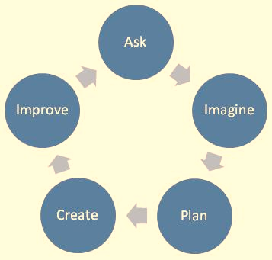
Engineering Design Process
ASK: What is the problem? How have others approached it? What are your constraints?
IMAGINE: What are some solutions? Brainstorm ideas. Choose the best one.
PLAN: Draw a diagram. Make lists of materials you will need.
CREATE: Follow your plan and create something. Test it out!
IMPROVE: What works? What doesn't? What could work better? Modify your designs to make it better. Test it out!
www.teachengineering.org
Notes:
Slide 12: Introduce the Engineering Design Process. Explain that engineers use it as a tool to help them more effectively solve problems.

Slide 13
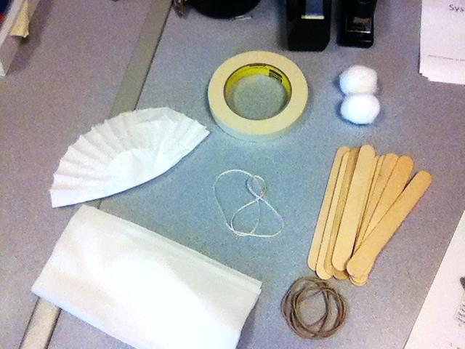
Engineering Design Process
Imagine (10 min.)
INDIVIDUALLY: observe available materials, and brainstorm and write design ideas (5 min.)
TEAM: share individual ideas (5 min.)
Plan (5 min.)
Choose and sketch a team design plan
Create (10 min.)
Gather materials
Construct your team design plan
Improve and Test (10 min.)
ADD PICTURE OF MATERIALS AGAIN HERE
Notes:
Slide 13: Explain how teams will use the engineering design process as they complete the challenge.
Imagine (10 min.)
INDIVIDUALLY: observe available materials, and brainstorm and write design ideas (5 min.)
TEAM: share individual ideas (5 min.)
Plan (5 min.)
Choose and sketch a team design plan
Create (10 min.)
Gather materials
Construct your team design plan
Improve and Test (10 min.)
Teams decide on and make any last minute improvements before testing
Each team tests their prototype while other teams observe.
If the crackers do not break on the first round, elevate the catapult and do a round two if time permits! This time the catapult should be placed on a table in a position where the cracker will be launched off the table to the floor (at least a 3 foot drop).

Slide 14
Design Reflection
What went well? Not so well? Why?
What aspects of other team designs stood out to you?
Did other designs give you ideas for ways to improve your design?
What modifications would you make if we had time to complete the design challenge again?
Notes:
Slide 14: Facilitate a whole group reflection on final prototype design and testing results by asking questions such as the following.
What do you like best about your design?
What do you like least about your design?
What aspects of other team designs stood out to you, and/or gave you ideas for improving your own team’s design?
What modifications would you make if we had time to complete the design challenge again?

Slide 15
Wrap Up
What ideas do you have for engineering a better world?
How can you turn ideas into reality?
Notes:
Slide 15: Conclude by discussing the following questions as post-activity surveys are distributed.
What ideas do you have for engineering a better world?
How can you turn ideas into reality?

Slide 16
This material is based upon work supported by the National Science Foundation under Grant No. EEC – 1009607 and through EiF grant 14.06
References:
Ohio's new learning standards. Ohio department of education. 08 Aug 2014. Retrieved from: http://education.ohio.gov/Topics/Ohio-s-New-Learning-Standards/Ohios-New-Learning-Standards
www.discovere.org
Notes:
Allow time for students to complete their post-activity survey.

