Slide 1
TURNING IDEAS INTO REALITY: ENGINEERING A BETTER WORLD
Assistive Device
www.discovere.org
Notes:
Slide 1: As the pre-activity survey is distributed to students, introduce yourself and provide enough of an activity overview to gain students excitement.
Allow time for students to individually complete their pre-activity survey.
Divide group into teams of 3 or 4 students.

Slide 2
What does an engineer do?
Solve problems, and shape the future!
Create and design new “things” essential to health, happiness and safety:
Chemical things – food, medicine, shampoo, fuels…
Building things – bridges, skyscrapers, roads…
Technology things – iPods, Cameras, electronic gadgets…
Fun things – toys, roller coasters, sporting goods...
Important things – water systems, medical devices and tools…
Much, much more….the list is endless
images.businessweek.com
www.wistatefair.com
www.gettyimages.com
Notes:
Slides 2 and 3: Discuss engineering and what engineers do.

Slide 3
How do engineers do this?
Help others by solving all sorts of problems.
Use one of their most important tools: their own creativity.
Work in design teams.
Use cool tools such as computers, microscopes, testing machines, etc.
Communicate with lots of people about problems they need solved.
Share ideas and solutions with others through presentations and/or writing.
www.engineeringmessages.org
Notes:
Do all engineers do the same thing?
NO, NO, NO!!!!!
Many types of engineers
Chemical
Mechanical
Electrical
Civil
They do many different types of jobs:
Design
Sale
Test
Much, much more!

Slide 4
Engineers Change Lives! Watch engineers design an assistive device to improve a life:
Engineering a Better World
Notes:
Present the engineering design problem and challenge, following presentation:
Slide 4: Play video (2m38s).

Slide 5
Engineering Design Problem
You have a friend with limited hand and wrist muscle control, making the simple daily task of putting on socks difficult. You know there has to be a way to help your friend solve this problem. You begin thinking about and researching the process of putting on a sock, and record the following facts.
To complete any task, muscles must have potential (waiting) energy that is transformed (changed) into kinetic (moving) energy.
When putting a sock on, muscles pick up and lift the sock, giving it gravitational potential energy waiting to transform into kinetic energy and fall to the ground.
When putting a sock on, muscles stretch the sock, giving it elastic potential energy waiting to transform into kinetic energy and move close to the body.
The problem must be that your friend’s muscles do not have enough energy to control the gravitational potential energy and elastic potential energy in the sock.
Notes:
Slide 5: Present the real-world engineering design problem (scenario).

Slide 6
Engineering Design Challenge
Today you are a mechanical engineer
You will design, build, and test an assistive device!
Pulling on a sock is difficult for people with limited hand and wrist muscle control. It is a struggle for their muscles to overcome the sock’s elastic potential energy when stretched, and its gravitational potential energy when lifted.
Now that you know the cause of the problem, you decide to take on the challenge of designing a solution! Your challenge is to use only the materials available to design and build a device prototype that can help people pull on their socks independently.
Notes:
Slide 6: Introduce the Engineering Design Challenge.

Slide 7
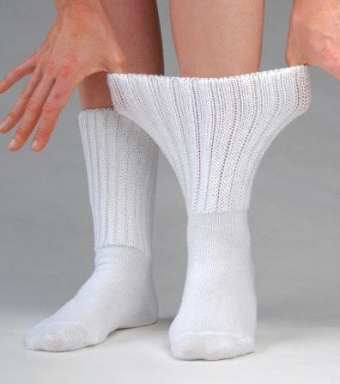
Design Goals
Device must help someone pull on a sock
Only provided materials can be used
Device cannot be attached to sock
Have fun!!
Notes:
Slide 7: Share Engineering Design Goals.

Slide 8
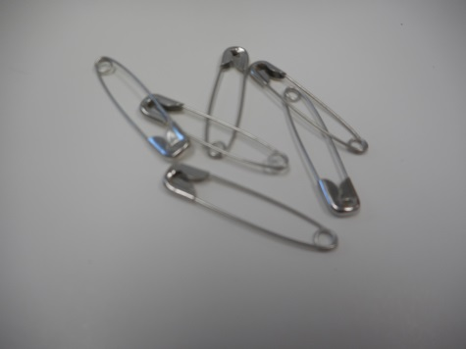
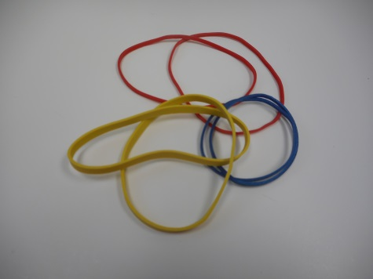
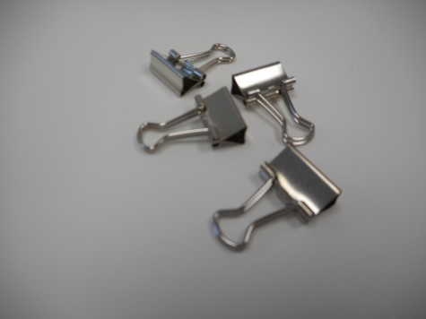
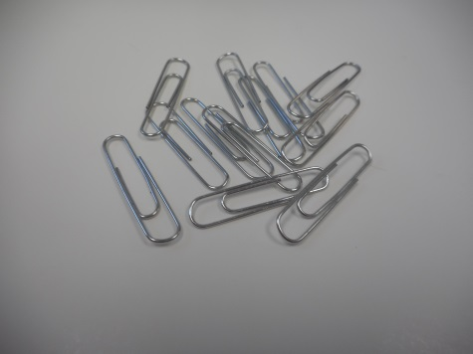
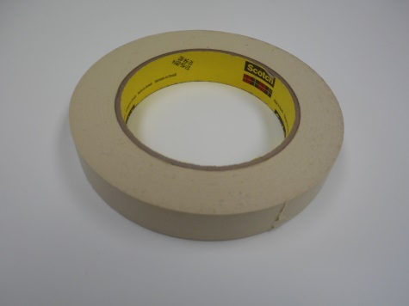
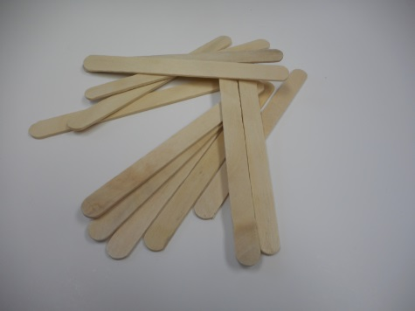
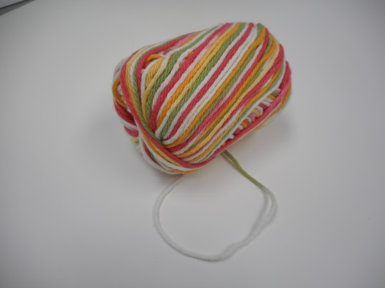
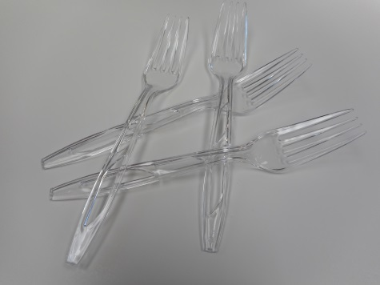
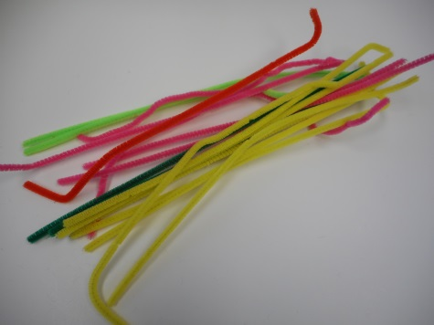
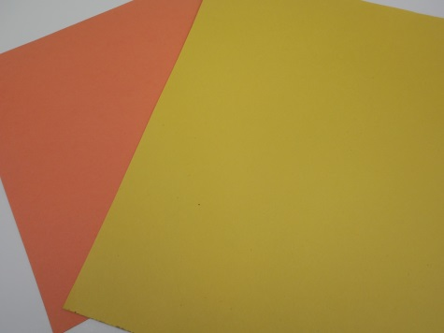
Materials
3
6
2
2
4 in
3
2 ft
2
4
1
Notes:
Slide 8: Introduce resources (materials) available to each team.
Materials: paperclips, binder clips, forks, yarn, rubber bands, craft sticks,
construction paper, safety pins, tape, pipe cleaners
Explain how teams will work.

Slide 9
Design Testing
Attach your device to the sock.
Use your device to pull the sock onto provided foot.
Use your device to take the sock off of provided foot.
Notes:
Slide 9: Explain prototype-testing procedures.
Design will be tested using a mannequin foot. Students must design a device that can be attached to a sock right before testing. The device will be used to help someone pull a sock onto the mannequin foot. Have students think about how easy it was to pull the sock onto the mannequin foot, or would it have been easier to their own foot.
Note: the design cannot be built on the sock. It must be something that can be attached during testing and detached after testing.

Slide 10
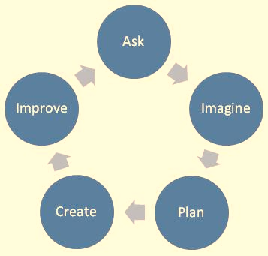
Engineering Design Process
ASK: What is the problem? How have others approached it? What are your constraints?
IMAGINE: What are some solutions? Brainstorm ideas. Choose the best one.
PLAN: Draw a diagram. Make lists of materials you will need.
CREATE: Follow your plan and create something. Test it out!
IMPROVE: What works? What doesn't? What could work better? Modify your designs to make it better. Test it out!
(source: www.teachengineering.org)
Notes:
Slide 10: Introduce the Engineering Design Process. Explain that engineers use it as a tool to help them more effectively solve problems.

Slide 11
Engineering Design Process
Imagine (10 min.)
INDIVIDUALLY: observe available materials, and brainstorm design ideas (5 min.)
TEAM: share individual ideas (5 min.)
Plan (5 min.)
Choose and sketch a team design plan
Create (10 min.)
Gather materials
Construct your team design plan
Improve and Test (10 min.)
Notes:
Slide 11: Explain how teams will use the engineering design process as they complete the challenge.
Brainstorm:
Each individual in a team must write or sketch one or two ideas.
Team must discuss each idea.
Team decides criteria most important to them while keeping constraints (limited time and materials, etc.) in mind.
Create Team Prototype:
Teams choose, sketch, and outline their prototype design idea.
Teams have idea approved by facilitator.
Gather Materials:
Teams receive their bag of materials (prepared in advance).
Create Chosen Design:
Team creates their approved prototype design plan.
Final Test:
Each team tests their prototype while other teams observe.

Slide 12
Design Reflection
What went well? Not so well? Why?
What aspects of other team designs stood out to you?
Did other designs give you ideas for ways to improve your design?
How challenging was it to pull the sock onto the foot?
Would be more or less challenging to pull the sock onto your own foot?
How did your device help overcome the sock’s elastic potential energy when it was stretched?
How did your device help overcome the sock’s and its gravitational potential energy when it was lifted?
Notes:
Slide 12: Facilitate a whole group reflection on final prototype design and testing results by asking questions such as the following.
What do you like best about your design?
What do you like least about your design?
What aspects of other team designs stood out to you, and/or gave you ideas for improving your own team’s design?
What modifications would you make if we had time to complete the design challenge again?
How challenging was it to pull the sock onto the foot?
Do you think it would be more or less challenging to pull the sock onto your own foot?

Slide 13
Wrap Up
What ideas do you have for engineering a better world?
How can you turn ideas into reality?
Notes:
Slide 13: Conclude by discussing the following questions as post-activity surveys are distributed.
What ideas do you have for engineering a better world?
How can you turn ideas into reality?

Slide 14
This material is based upon work supported by the National Science Foundation under Grant No. EEC – 1009607 and through EiF grant 14.06
References:
Ohio's new learning standards. Ohio department of education. 08 Aug 2014. Retrieved from: http://education.ohio.gov/Topics/Ohio-s-New-Learning-Standards/Ohios-New-Learning-Standards.
www.discovere.org
Notes:
Allow time for students to complete their post-activity survey.

